Slide 1

Object Orientated Software Engineering
5.2 Design Patterns and the Strategy Pattern
By Stephen Lindsay

Slide 2
Outline
Where do OO principles fall short
The strategy design pattern
What is the purpose of design patterns?

Slide 3
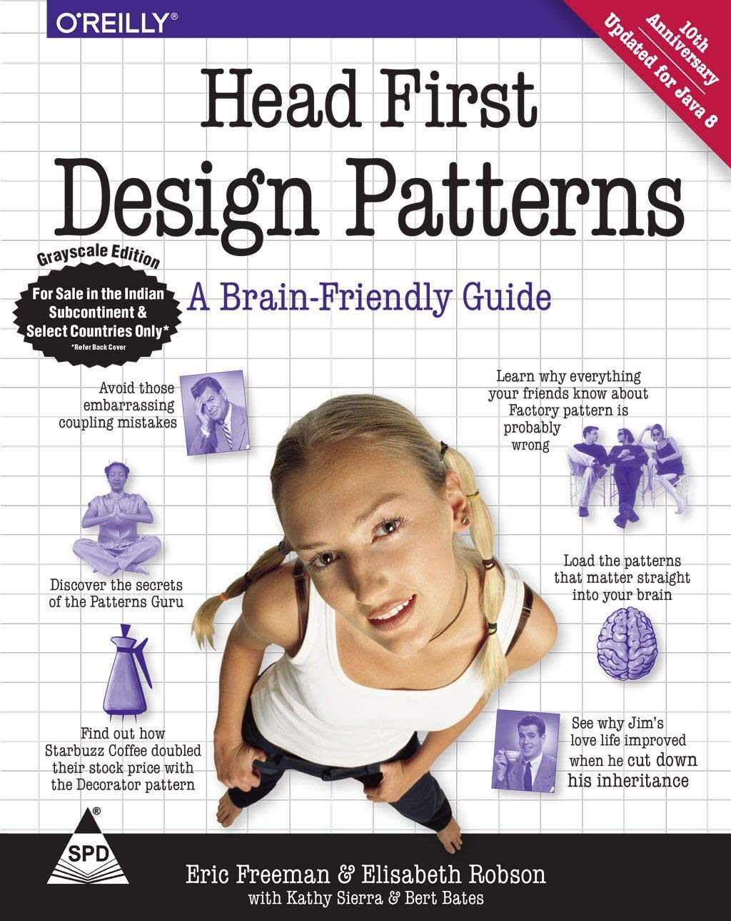

Image taken from Head First Design Patterns, Title Page and C1

Slide 4
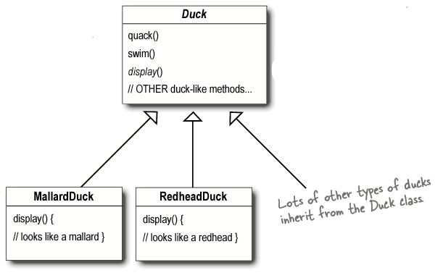
Duck!
Image taken from Head First Design Patterns, Chapter 1
Notes:
Supercalsses and subclasses in the inheritance relationship

Slide 5
What sorts of problem?
We want to modify Duck to allow it to have a fly method
What’s the basic Java solution to doing this?
Why might this solution go wrong?

Slide 6
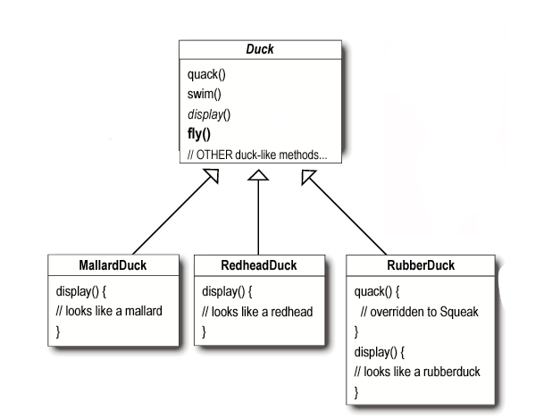
Image taken from Head First Design Patterns, Chapter 1
Notes:
Solution and problem

Slide 7
What sorts of problem?
We want to modify Duck to allow it to have a fly method
The basic java approach of implementing the solution in the superclass Duck has some serious shortcomings as code gets into places where it should not be
We can override the fly() method in RubberDuck, but that doesn’t help when we add WoodenDuck
Okay, we talked about how we liked interfaces though, can they help?

Slide 8
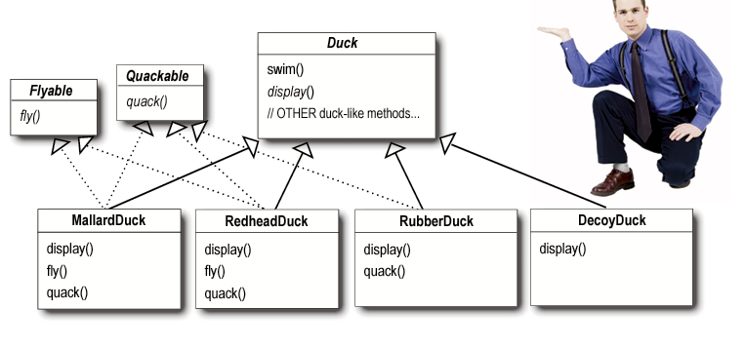
Image taken from Head First Design Patterns, Chapter 1

Slide 9
What sorts of problem?
We want to modify Duck to allow it to have a fly method
The basic java approach of implementing the solution in the superclass Duck has some serious shortcomings as code gets into places where it should not be
We can override the fly() method in RubberDuck, but that doesn’t help when we add WoodenDuck
Interfaces make duplicate code into a way of life here, this would be a nightmare to maintain

Slide 10
What is the fundamental problem?
The fundamental issue here is the variation we need to manage in the code – every time we change something we break something
Design Principle: Identify the aspects of your application that vary and separate them from what stays the same
This principle will hold true for many different design patterns as we explore them

Slide 11
What varies in this problem?
What needs to be able to change?

Slide 12
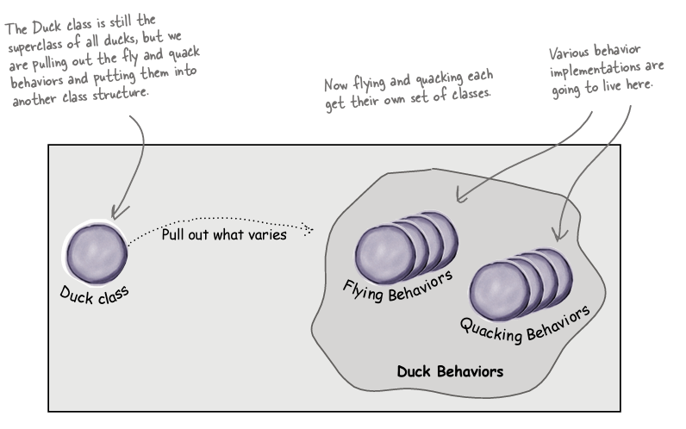
Image taken from Head First Design Patterns, Chapter 1

Slide 13
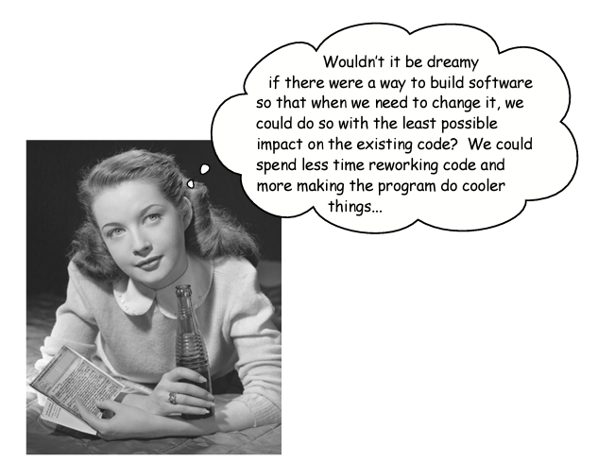
Image taken from Head First Design Patterns, Chapter 1

Slide 14
Duck Behaviours
We want to build a flexible system and ideally assign behaviours at start up – for example, a MallardDuck with flyRealFast – this get’s easy when we consider principle two
Design Principle – Program to an interface, not an implementation
Instead of implementing the fly and quack behaviours in the Duck classes, we implement them in some behaviour classes
Our new approach allows us to hide the implementation of a behaviour behind an interface

Slide 15
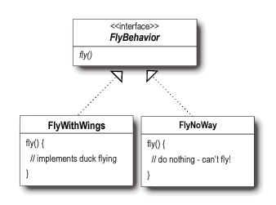
Notice the no-implementation implementation, a common necessity for this approach
Image taken from Head First Design Patterns, Chapter 1

Slide 16
Duck Behaviours
Programming to an interface really means programming to a supertype, to phrase this very clunkily:
“the declared type of a variables should be a supertype, usually an abstract class of interface, so that the objects assigned to those variables can be of any concrete implementation of the supertype, which means the class declaring them doesn’t have to know about the actual object types”
- Head First Design Patterns

Slide 17
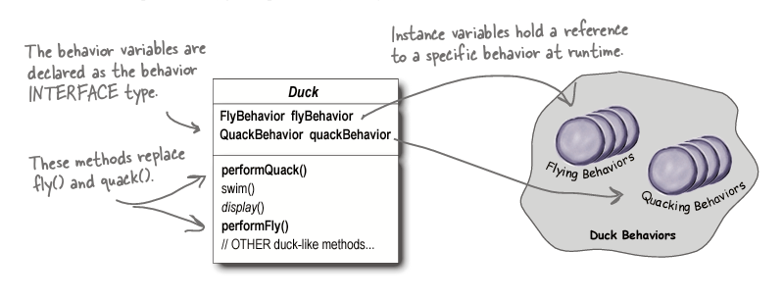
Image taken from Head First Design Patterns, Chapter 1

Slide 18
Instantiating Behaviours
Public class MallardDuck extends Duck {
public MallardDuck() {
quackBehaviour = new Quack();
flyBehaviour = new FlyWithWings();
}
public void performQuack() {
quackBehaviour.quack();
}

Slide 19
What happens if our Mallard gets hurt one day?

Slide 20
What happens if our Mallard gets hurt one day?
mallard.changeFlyBehaviour(new FlyWithInjuredWing());

Slide 21
Instantiating Behaviours
Public class MallardDuck extends Duck {
public MallardDuck() {
quackBehaviour = new Quack();
flyBehaviour = new FlyWithWings();
}
public void changeFlyBehaviour(FlyBehaviour fb) {
flyBehaviour = fb;
}

Slide 22
HAS-A beats out IS-A
Design Principle: Favour composition over inheritance
The approach we have been describing here is favouring composition over inheritance
Composition means Object A HAS-A Object B
Duck has a fly behaviour! Simple!
Inheritance means Object A IS-A Object B
Duck is a fly behaviour? No thanks!
The second advantage of this approach we have already seen is that we can switch out behaviours at runtime

Slide 23
The Strategy Pattern
You’ve just applied your first design pattern!
The Strategy Pattern defines a family of algorithms, encapsulates each one, and makes them interchangeable. Strategy lets the algorithm vary independently from the class using it.

Slide 24
What are design patterns?
“At any given moment, someone struggles with the same software design problems you have. And, chances are, someone else has already solved your problem.”
Head First Design Patterns
Design patterns are strategies we use when we recognise a type of information management problem
Less specific than OO principles, much less specific than a programming language, patterns recognise ideas or common problems

Slide 25
What sorts of problem?
Broadly speaking, the sorts of problems we manage can be divided into three categories:
Creational Design Patterns – we need to manage the instantiation of an object, for example, we want to have a single instance of an object managing a database connection
Structural Design Patterns – we need to organise how we let groups of classes interact with one another, for example, we need two class instances in different JVMs to talk to one another
Behavioural Design Patterns – we need to manage common patterns of communication to an object respecting the Open/Closed paradigm, for example, we want to let behaviour of an object or system change at runtime

Slide 26
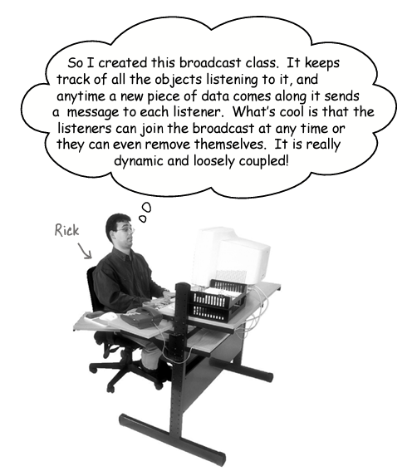
Image taken from Head First Design Patterns, Chapter 1

Slide 27
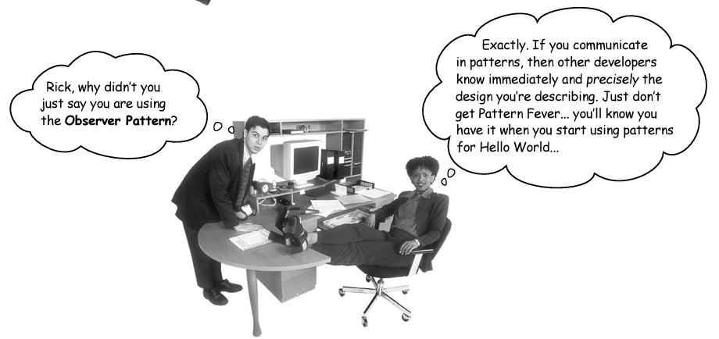
Image taken from Head First Design Patterns, Chapter 1

Slide 28
A shared vocabulary
Powerful - Design patterns create a language that lets you talk about the problems and solutions
Saying more with less – One word that conveys an entire structure
Staying in Design Longer – When you don’t have to talk about implementation, you can stay at the design level thinking about the bit problems
Reduce misunderstandings – The specific nature of design patterns means there is less chance for miscommunication
Onboarding and community building – A rapid way of junior developers to get up to speed in their team, a focused way to teach big ideas

Slide 29
Outline
Where OO principles fall short - Working through the Duck problem should illustrate to us that sometimes inheritance and abstraction are not enough to make our code avoid duplication
The strategy design pattern – Three design principles applied to the way we get behaviours into classes and change them at runtime
What is the purpose of design patterns? – A shared vocabulary that addresses issues of creation, structure and behaviour

